Slide 1


Spotify Analysis
Prianka Kibria

Slide 2
Getting to know the data:
The data has been extracted from Kaggle. This particular data is the Top 200 Weekly Global charts on Spotify. It contains songs that have been played most frequently and have been able to reach the top 200. Please note for this particular analysis I will only be focusing on the top 10 songs.
Dataset Reference: https://www.kaggle.com/datasets/sashankpillai/spotify-top-200-charts-20202021/code

Slide 3

Data Cleaning:
#1. The columns Index, Song ID, Chord, Week of Highest Charting, and Weeks Charted have been dropped using the following code:
#Dropping unneccessary columns with either no distributing values or unique values that are not needed
spotify.drop(columns = ['Index', 'Song ID', 'Chord', 'Week of Highest Charting', 'Weeks Charted'], inplace = True)
Reason: The reason to why these columns were dropped because it was unnecessary towards this particular analysis as well as have contained unique values that were not needed.

Slide 4

Data Cleaning Cont
#2: Removed commas in column “Streams” as it created a unique value
spotify.Streams = spotify.Streams.apply(lambda Streams : Streams.replace(',', ''))

Slide 5

Data Cleaning Cont
#3: The data types for the following have been changed because they were classified as object datatypes, however were numeric values:
streams
aritst followers
danceability
energy
loudness
speechiness
acousticness
liveness
tempo
duration
Allobjectcolumns = ['Artist Followers', 'Danceability', 'Energy', 'Loudness', 'Speechiness', 'Acousticness', 'Liveness', 'Tempo', 'Duration (ms)', 'Valence']
#code ref for loop: Stackedoverflow + Kaggle
for each_col in Allobjectcolumns:
spotify[each_col] = pd.to_numeric(spotify[each_col], errors = 'coerce')

Slide 6
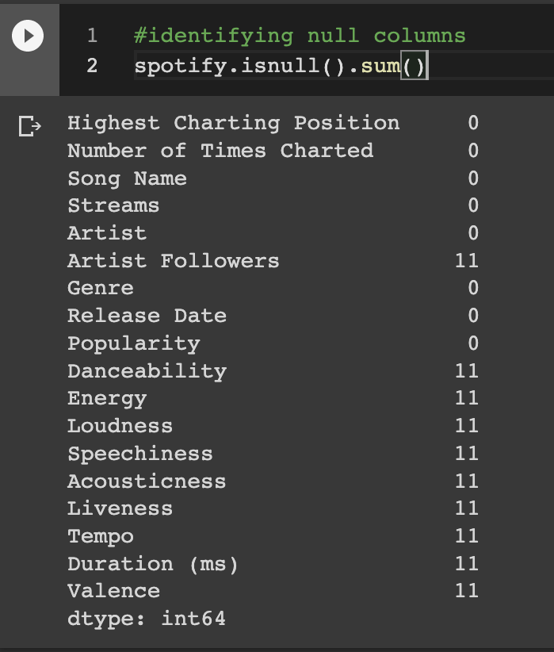
Handling null columns:
Given that the amount of null columns are very minimal and I will utilize the columns that have null columns I will be dropping them. I will not be losing too much data and will still have sufficient data after dropping them.
spotify = spotify.dropna()

Slide 7
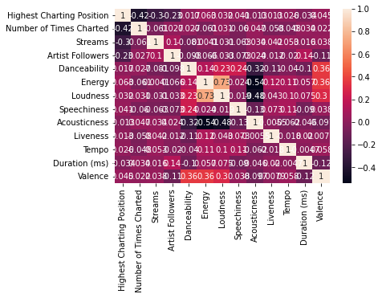
We are addressing the correlation between the top 10 charted song and its characteristics
Findings from the correlation map (to name a few):
Highest charting and energy has a high positive correlation
Number of times charted and energy has a high positive correlation
Streams and Danceability has a high positive correlation
Artist followers and speechiness has a high positive correlation
Danceability and valence has a high positive correlation

Slide 8
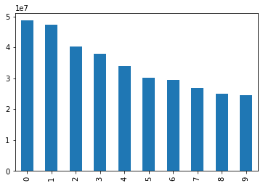
Assessing the target: Streams
We can note that based on the top 10 songs here songs 0 and 1 have the highest streams and song 9 has the lowest.
spotify['Streams'].head(10).plot.bar()

Slide 9
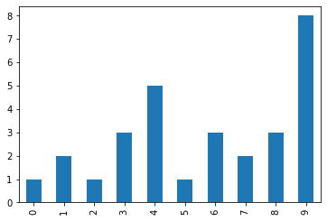
Highest Charting Position
No.9 holds the highest charting position and No.0 holds the lowest charting position record.

Slide 10
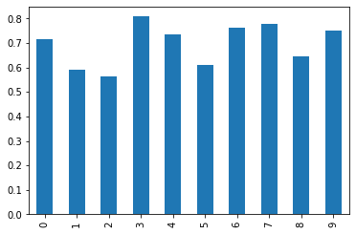
Danceability:
The danceability of No. 3 is the highest and No. 2 is the lowest.
spotify['Danceability'].head(10).plot.bar()

Slide 11
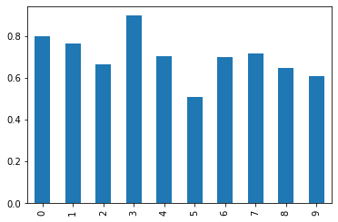
Energy:
As noted earlier energy levels have a positive distribution, and we can see here that there is a nice distribution of energy levels and its impacts on streams. A lot of the streams have a higher distribution than the other characteristics mentioned earlier.
spotify['Energy'].head(10).plot.bar()

Slide 12



Aha! My discoveries
There are some characteristics of music that impacts its charting position
Streams are primarily interdependent on its sound characteristics.
Followers of artist may have a small impact on streams.
Energy levels depict higher levels of streams

Slide 13

During this process I have not come across any challenges in assessing this data. What I hope to find are the key characteristics contributing to the rank of charting placing songs on top 10.

